Slide 1

PROJECT PRESENTATION
Presentation by:
Hare Raaj.E

Slide 2
OUTLINE
ABSTRACT
MODULE IMPLEMENTATION
MODULE SCREENSHOTS
DATABASE ER DIAGRAM
TABLES
OPTIONAL CLASS DIAGRAM
TESTING
FUTURE ENHANCEMENT

Slide 3
ABSTRACT
Ecommerce (or electronic commerce) is the buying and selling of goods (or services) on the internet. It encompasses a wide variety of data, systems, and tools for online buyers and sellers, including mobile shopping and online payment encryption.
Using Ecommerce a person sitting in front of screen is able to buy and sell products from and to any other parts of the world. In this Project I have implemented a simple ecommerce website dealing with the sale of electronic products like mobile, earphones, speakers and other devices.

Slide 4
IMPLEMENTATION MODULES
BACKEND
FRONTEND
DB CONFIG
CLASS
DAO CLASS
TEST CLASS
CONTROLLER CLASS
JSP PAGES
ENTITY CLASS
DAO IMPL
CLASS

Slide 5

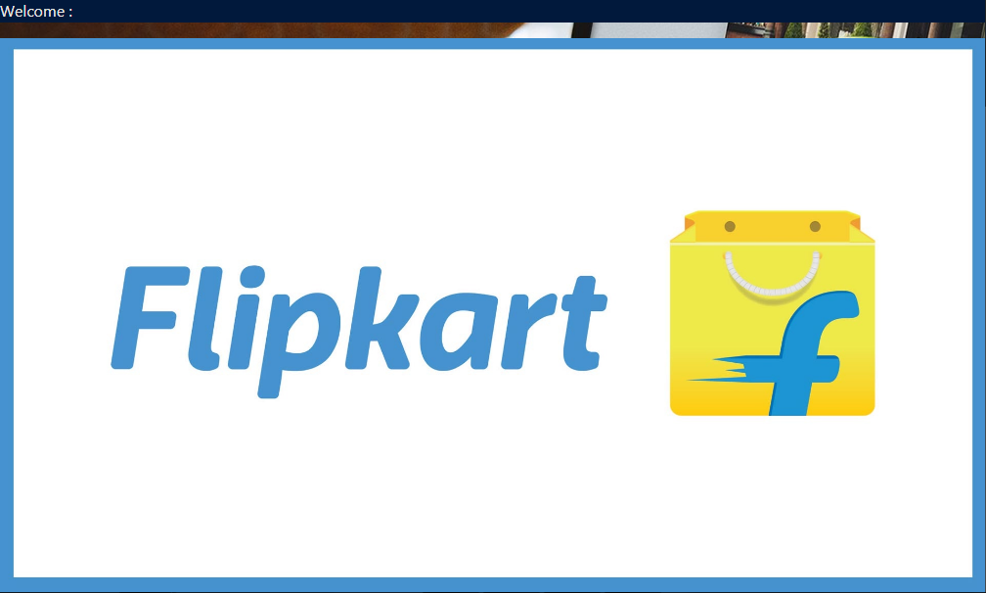
MODULE SCREENSHOT

Slide 6
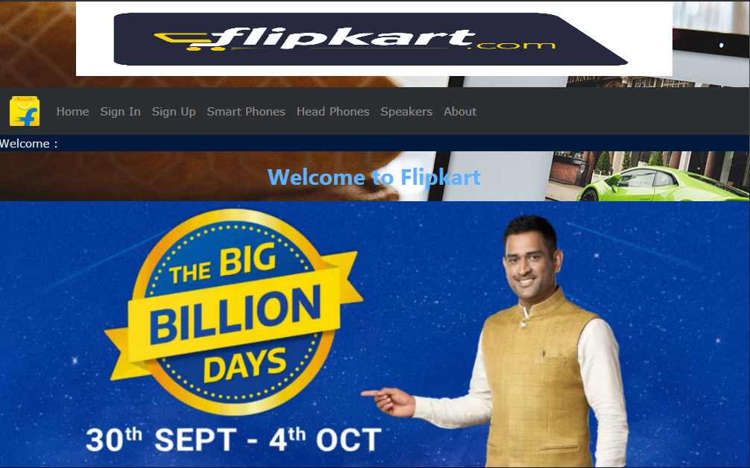
MODULE SCREENSHOT

Slide 7
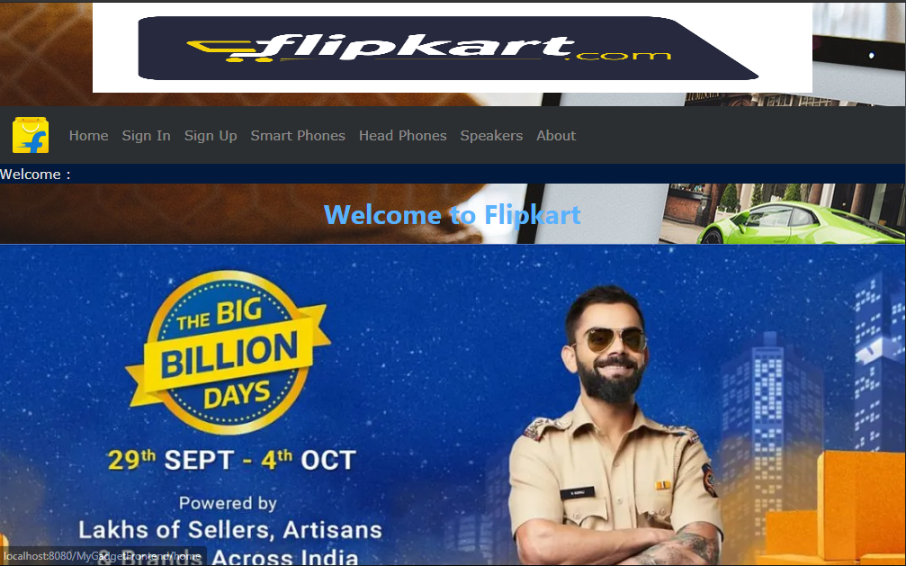
MODULE SCREENSHOT

Slide 8

MODULE SCREENSHOT

Slide 9
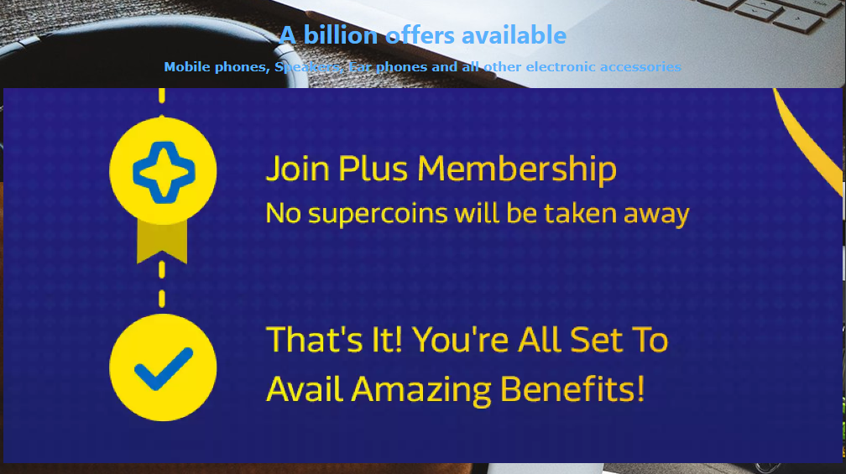
MODULE SCREENSHOT

Slide 10
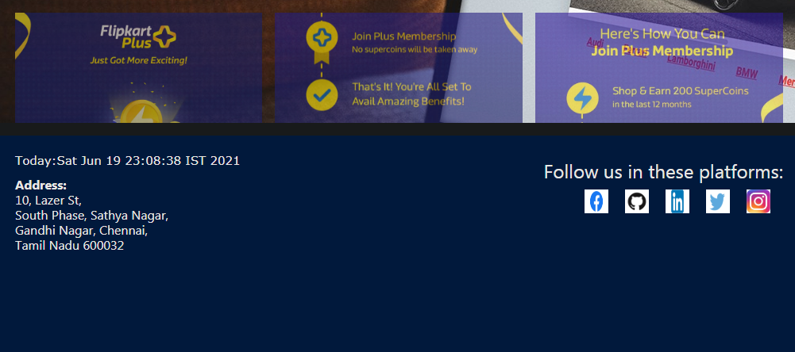
MODULE SCREENSHOT

Slide 11
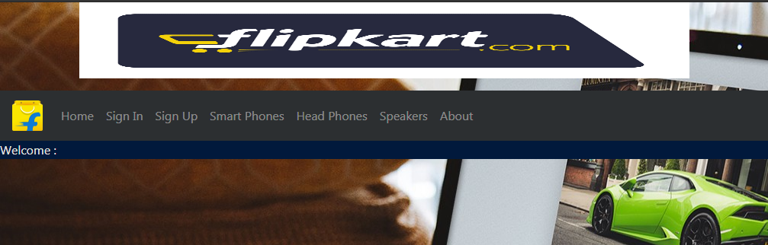
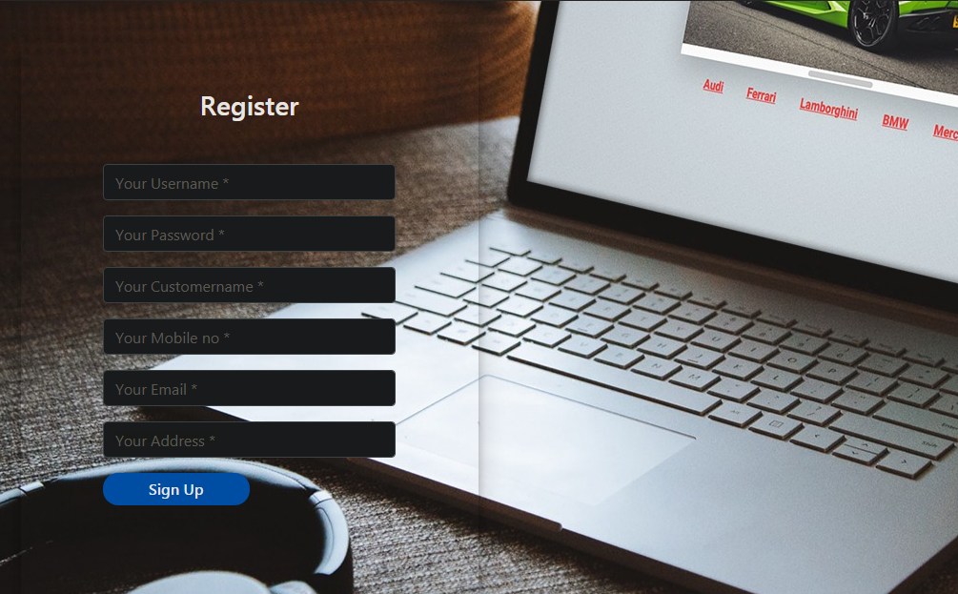
MODULE SCREENSHOT

Slide 12
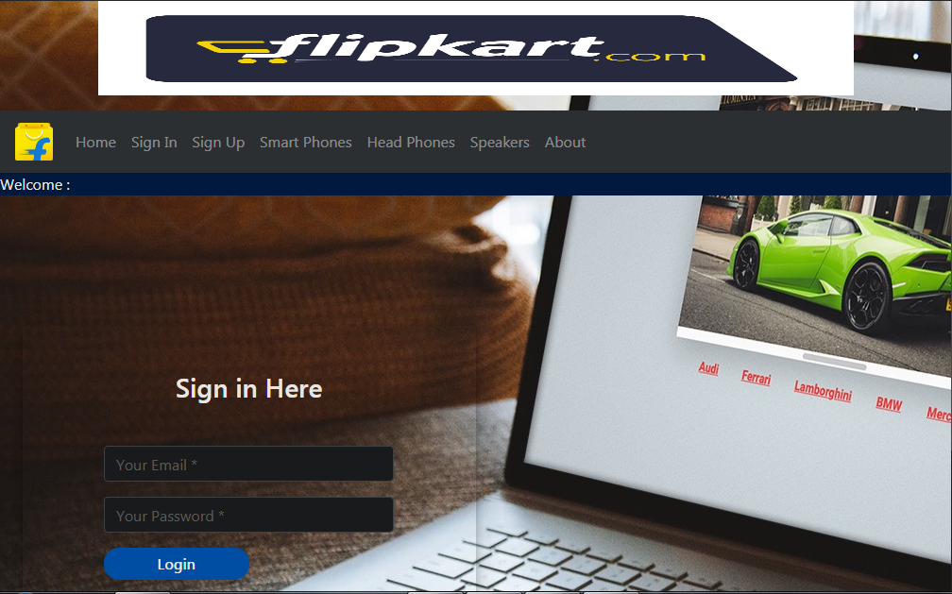
MODULE SCREENSHOT

Slide 13
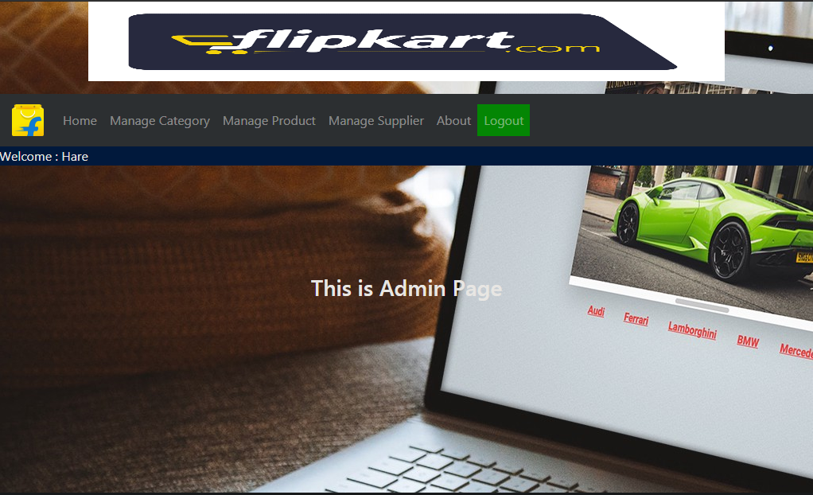
MODULE SCREENSHOT

Slide 14
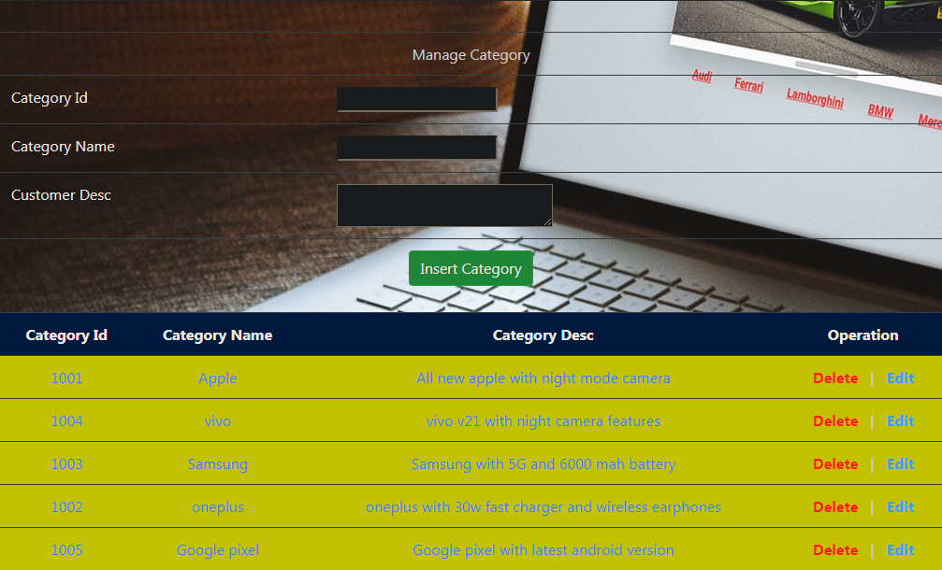
MODULE SCREENSHOT

Slide 15
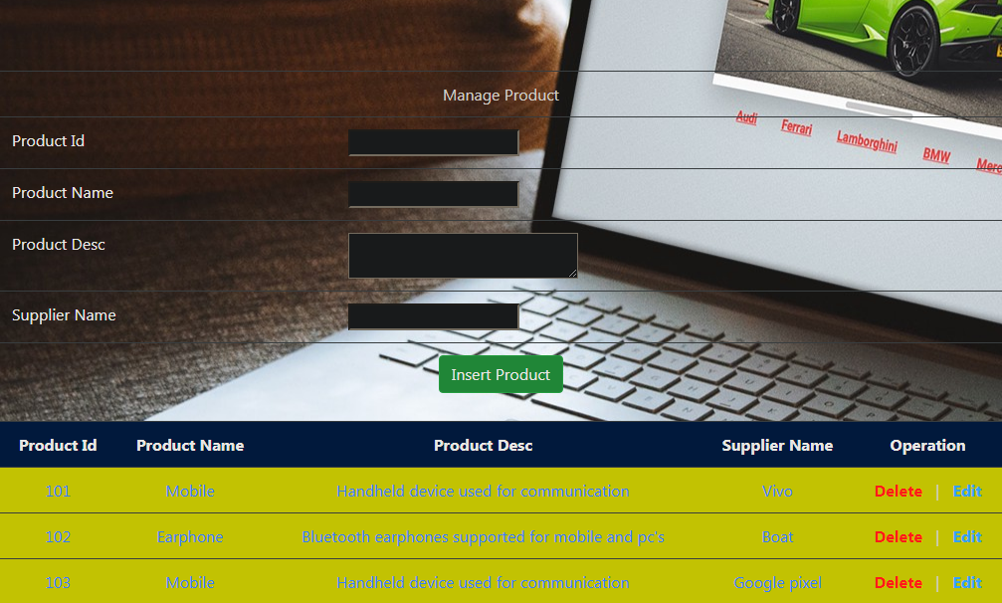
MODULE SCREENSHOT

Slide 16
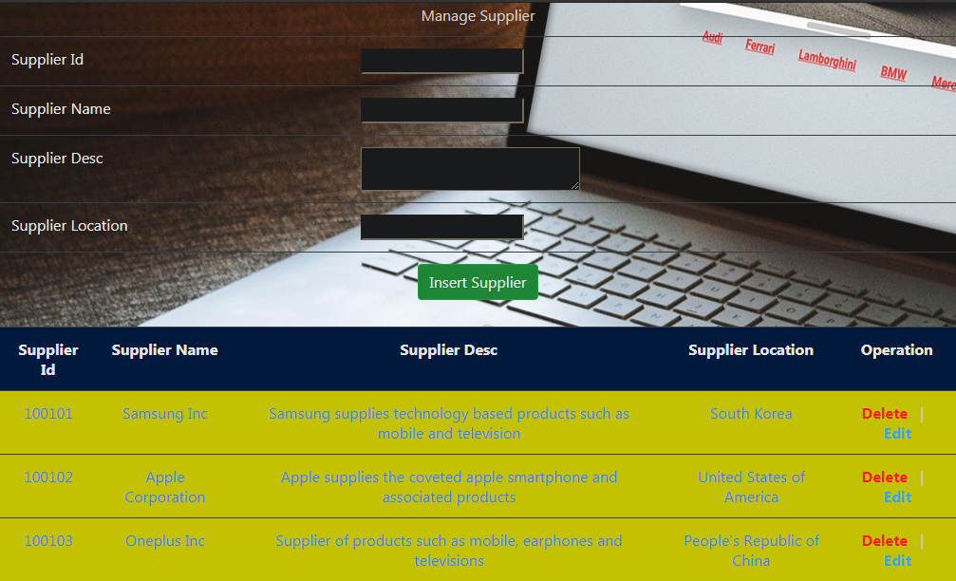
MODULE SCREENSHOT

Slide 17
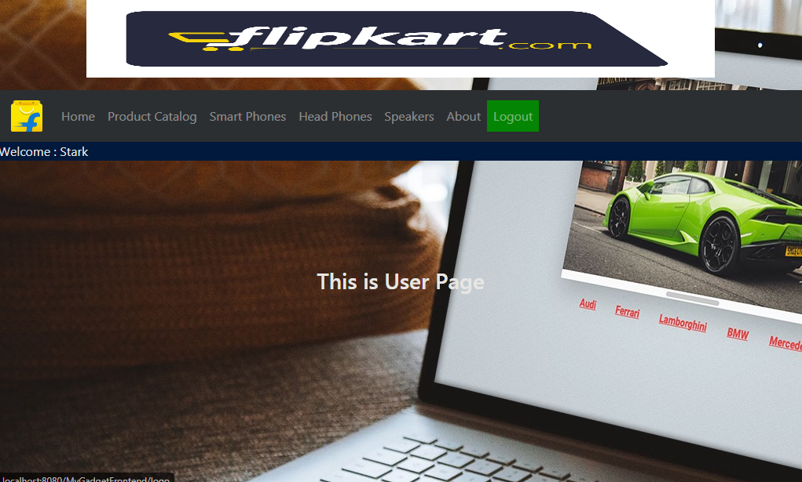
MODULE SCREENSHOT

Slide 18
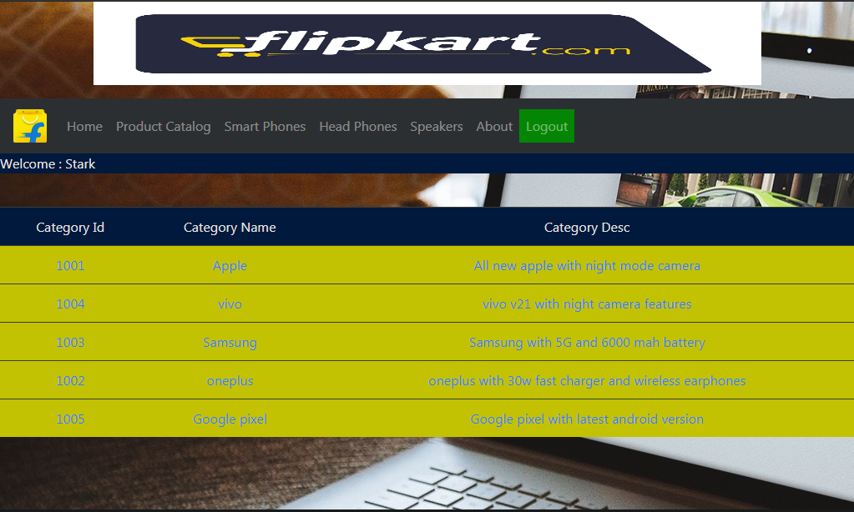
MODULE SCREENSHOT

Slide 19
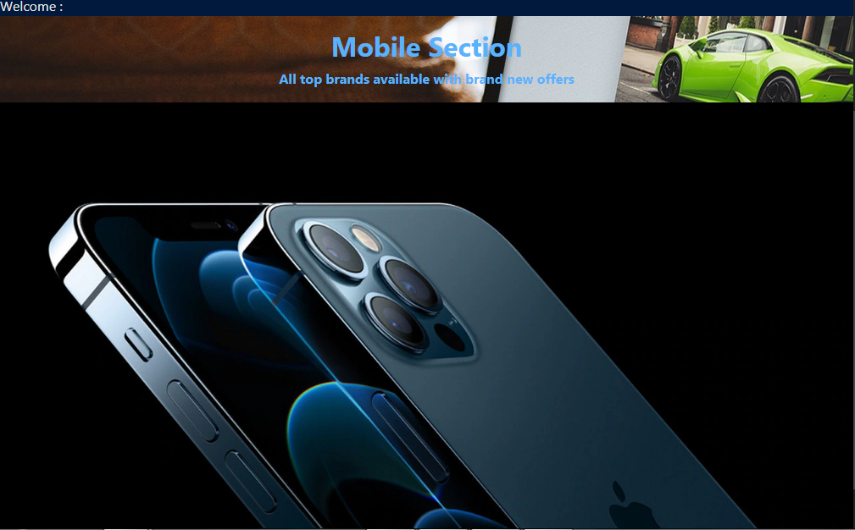
MODULE SCREENSHOT

Slide 20
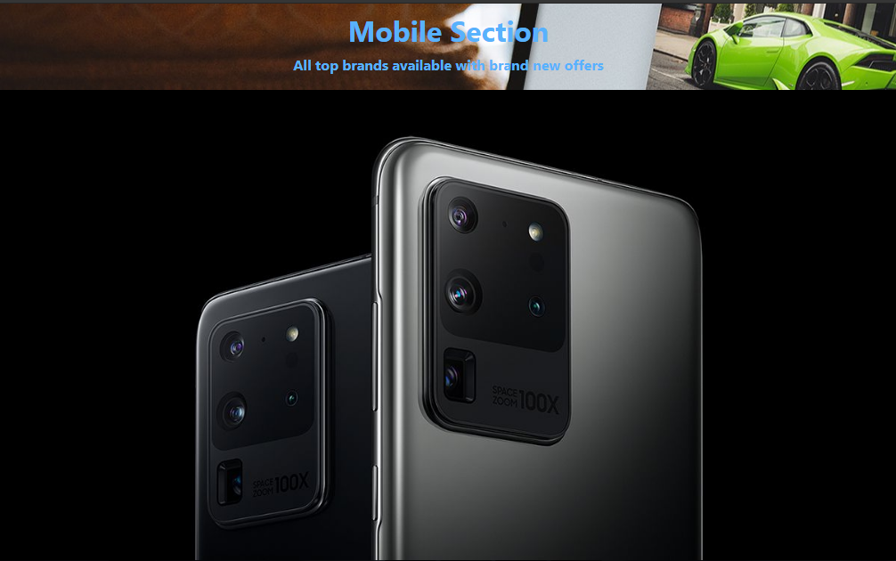
MODULE SCREENSHOT

Slide 21
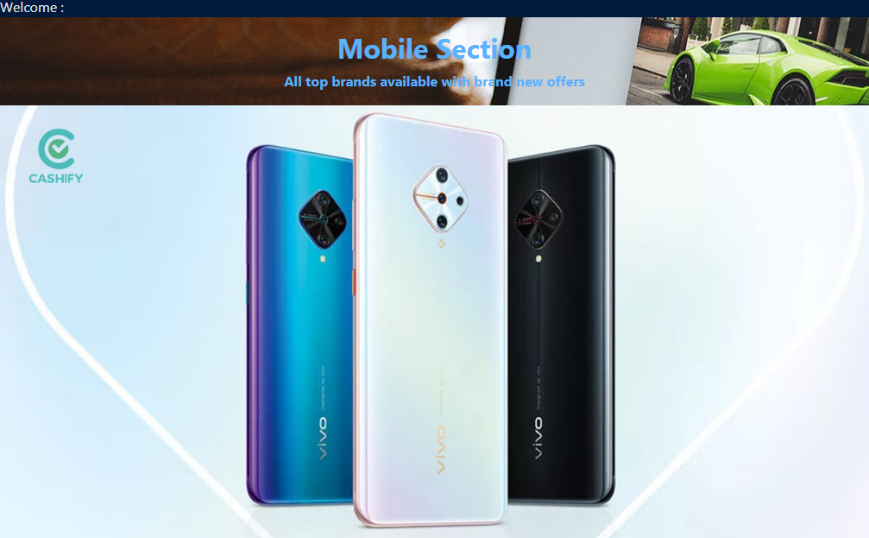
MODULE SCREENSHOT

Slide 22
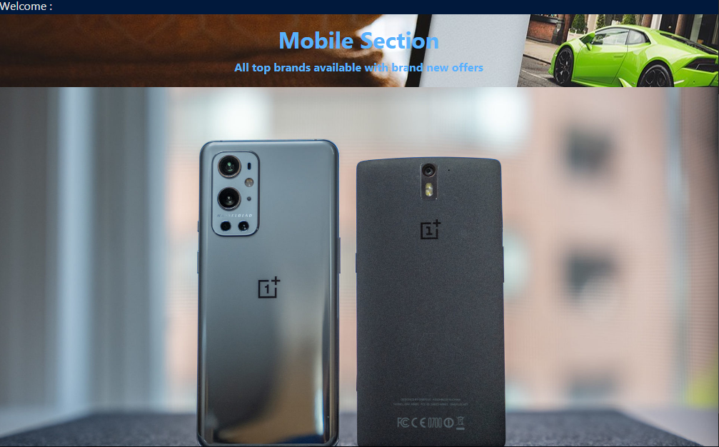
MODULE SCREENSHOT

Slide 23
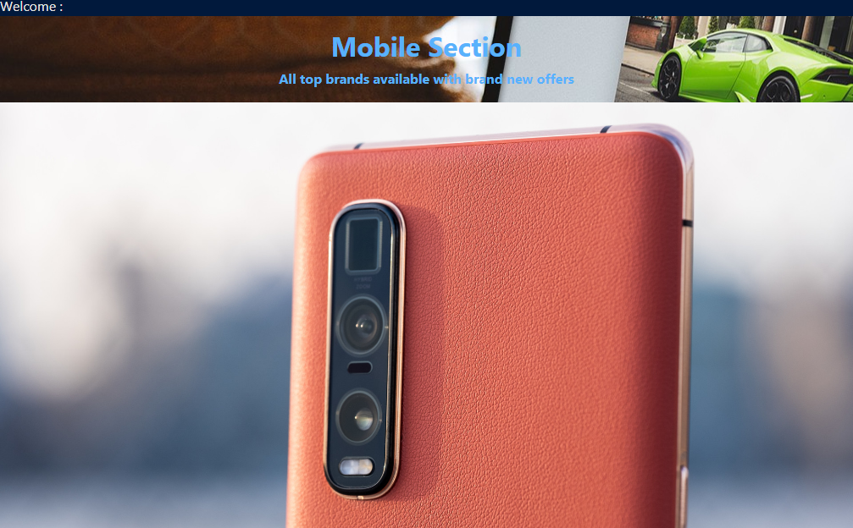
MODULE SCREENSHOT

Slide 24
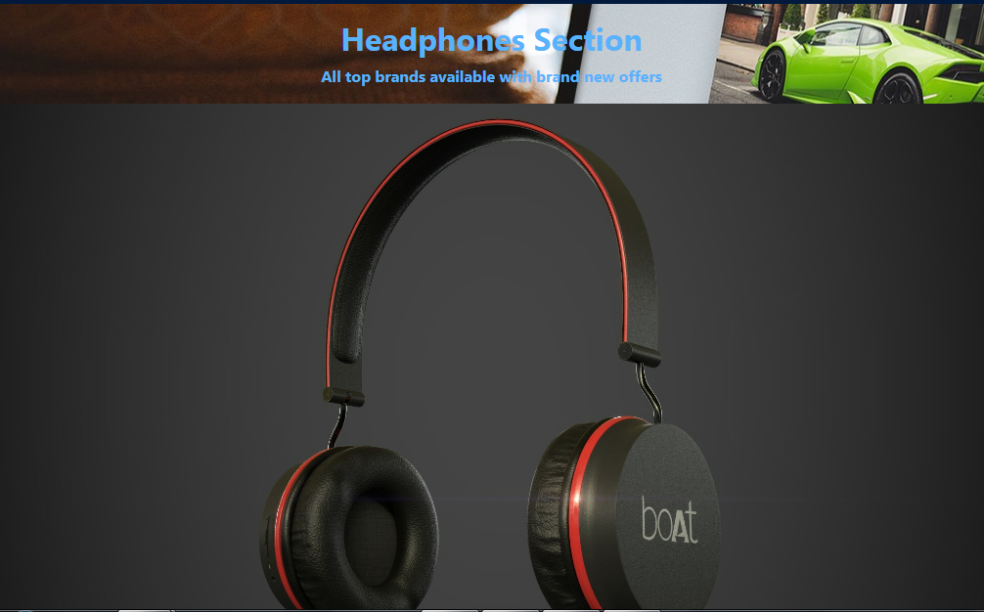
MODULE SCREENSHOT

Slide 25
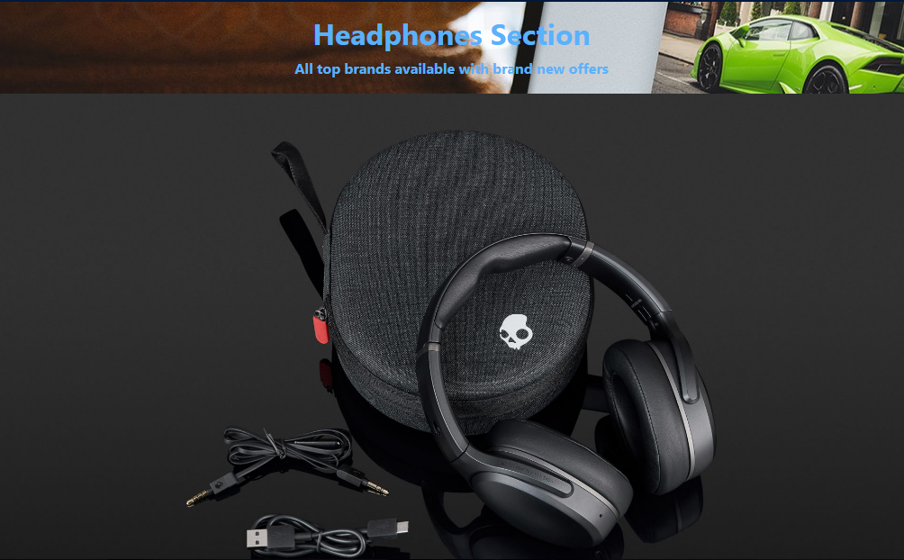
MODULE SCREENSHOT

Slide 26
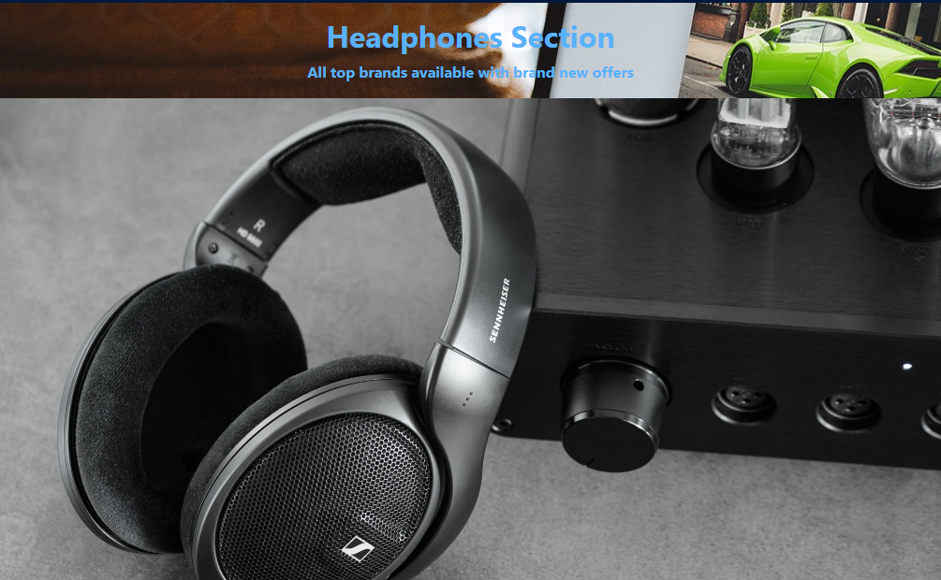
MODULE SCREENSHOT

Slide 27
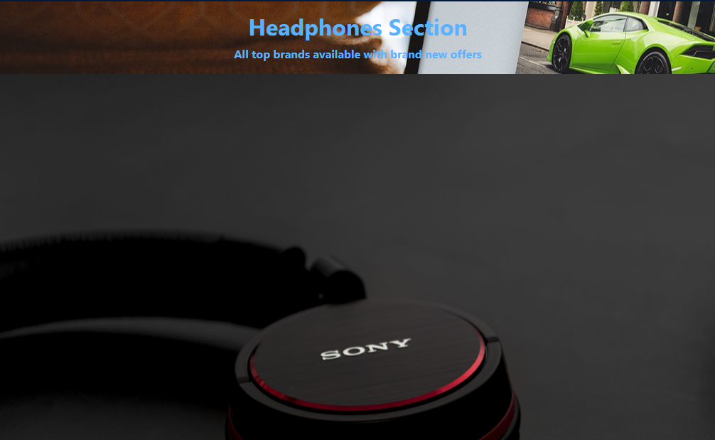
MODULE SCREENSHOT

Slide 28
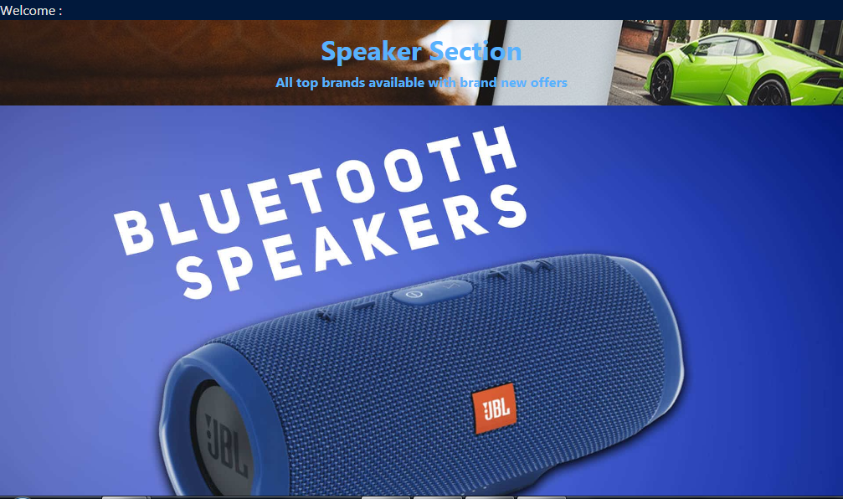
MODULE SCREENSHOT

Slide 29
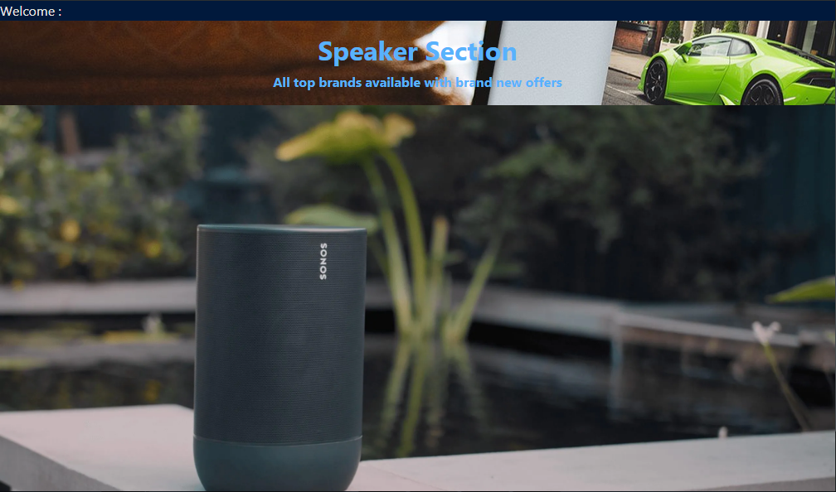
MODULE SCREENSHOT

Slide 30
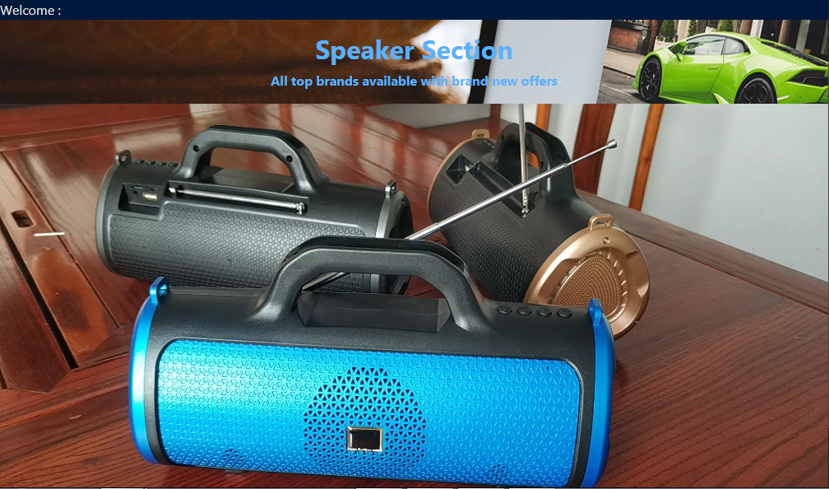
MODULE SCREENSHOT

Slide 31
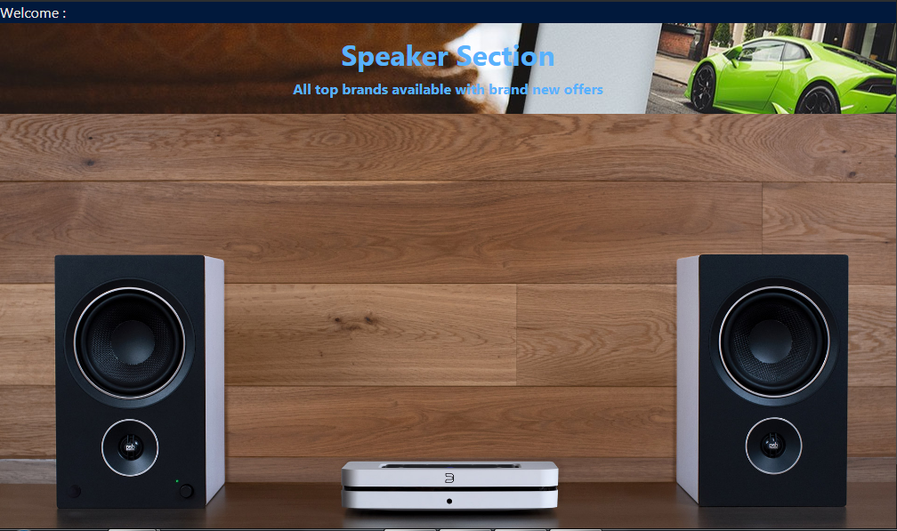
MODULE SCREENSHOT

Slide 32
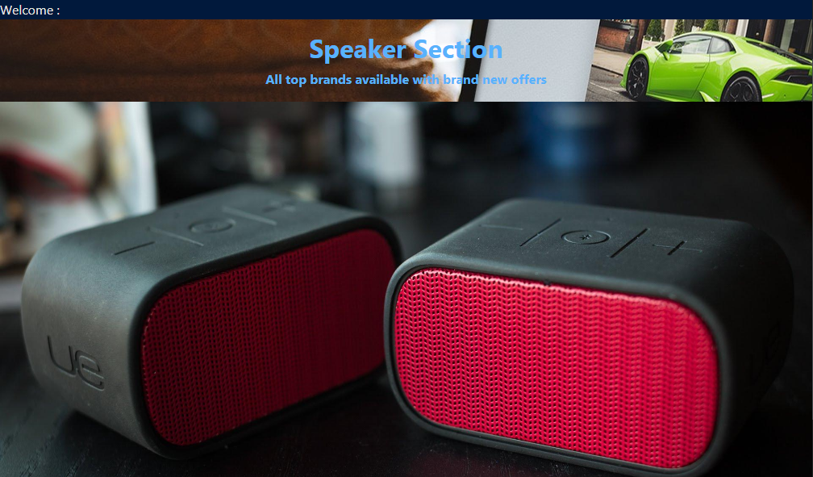
MODULE SCREENSHOT

Slide 33
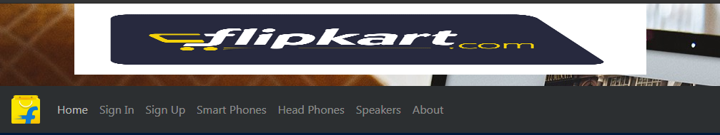
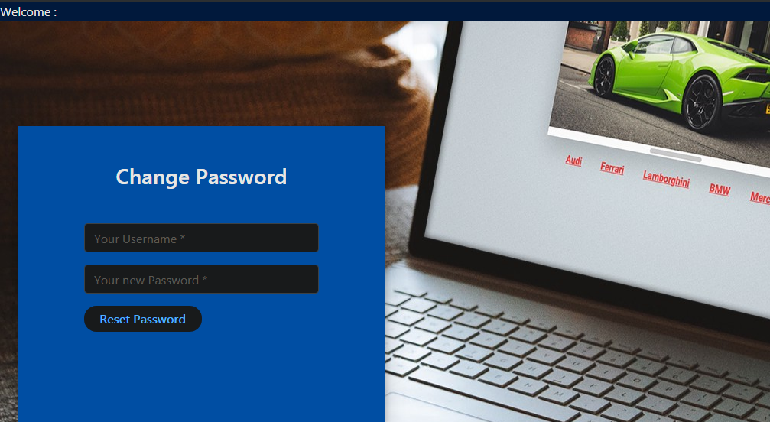
MODULE SCREENSHOT

Slide 34
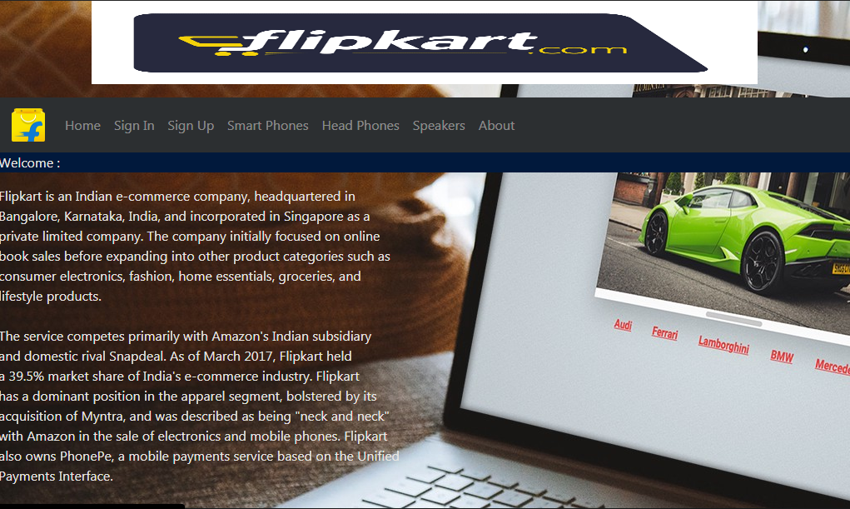
MODULE SCREENSHOT

Slide 35
DATABASE ER DIAGRAM
User
Role
Product catalog
User
Username
Password
supplierId
Admin
Supplier
Category
supplierName
categoryId
Product
categoryDesc
supplierLocation
categoryName
supplierDesc
productId
supName
productName
productDesc

Slide 36
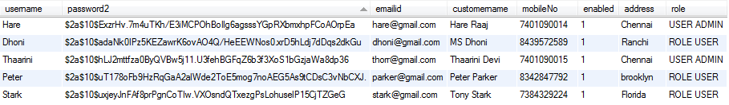
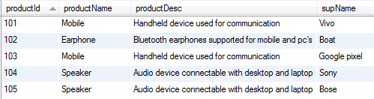
TABLES
USERDETAIL TABLE:
PRODUCT TABLE:

Slide 37
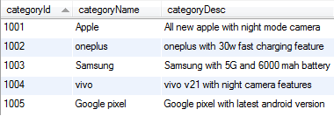
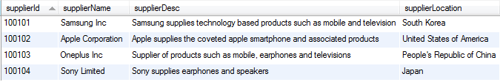
TABLES
CATEGORY TABLE:
SUPPLIER TABLE:

Slide 38
OPTIONAL CLASS DIAGRAM
CUSTOMER CLASS
PRODUCT CLASS
int categoryId;
String categoryName;
String categoryDesc;
int productId;
String productName;
String productDesc;
String supName;
+addCategory();
+updateCategory();
+deleteCategory():
+getCategories()
+getCategory()
+addProduct();
+updateProduct();
+deleteProduct();
+getProducts();
+getProduct();

Slide 39
OPTIONAL CLASS DIAGRAM
USERDETAIL CLASS
SUPPLIER CLASS
String username;
String password2;
String customerName;
String role;
String address;
String mobileNo;
String emailid;
Boolean enabled;
int supplierId;
String supplierName;
String supplierDesc;
String supplierLocation;
+addSupplier();
+updateSupplier();
+deleteSupplier();
+getSuppliers();
+getSupplier();
+registeruser();
+updateuser();
+getUser();

Slide 40
TESTING
UNIT TESTING is a type of software testing where individual units or components of a software are tested. The purpose is to validate that each unit of the software code performs as expected.
Unit testing finds problems early in the development cycle. This includes both bugs in the programmer's implementation and flaws or missing parts of the specification for the unit.

Slide 41
FUTURE ENHANCEMENT
Implementing cart features to enable user to select products
Enabling change password by using Otp enabled mail to emailid
Addition of payment features
Addition of 2 factor authentication for increased security

Slide 42
THANK YOU

